Slide 1
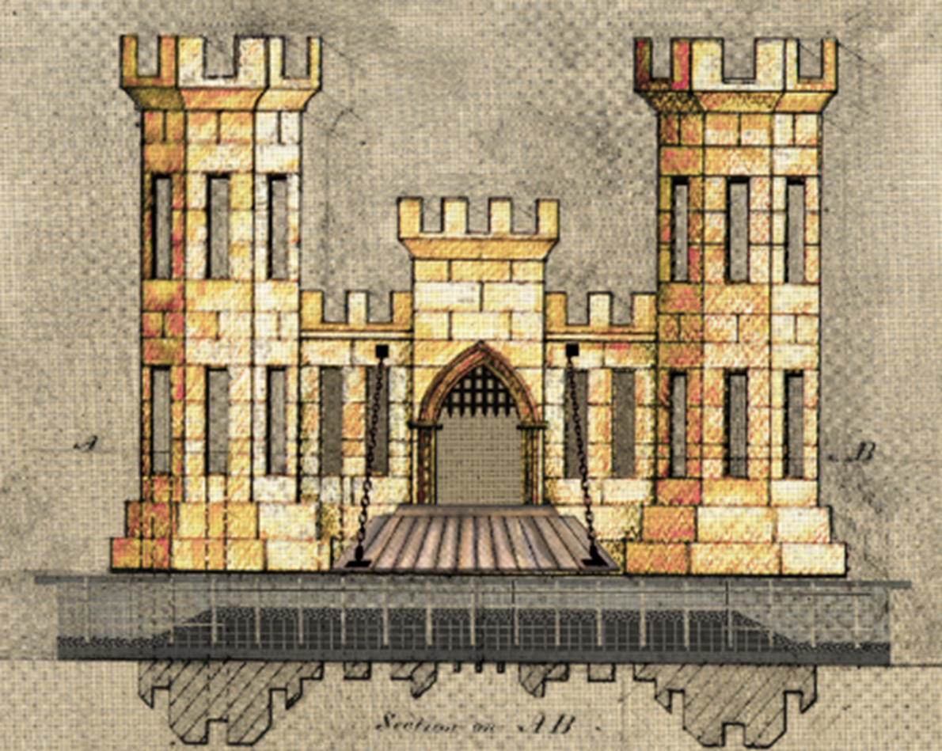
Program Overview “North to the Future”
Jim Jeffords
*Chief, Construction & Operations Division
James Sauceda
*Chief, Engineering Division
Tracy Wickham
* Chief, Contracting Division
Ryan Zachry
*Small Business Professional
Alaska District
U.S. Army Corps of Engineers
06 November 2024

Slide 2
MILITARY CONSTRUCTION OPPORTUNITIES FISCAL YEAR 2025-2027
PROJECT / LOCATION | VALUE | EXECUTION STRATEGY | CONTRACT TYPE | SOLICITATION TARGET | AWARD TARGET
Joint Integrated Testing and Training Center, JBER* | $250M - $400M | D/B/B, AE | Unrestricted | 2QFY25 | 4QFY25
Sand Storage Facility, JBER | $8M-$10M | D/B/B, IH | TBD | 3QFY25 | 4QFY25
Army National Guard Readiness Center, JBER | $50M - $75M | D/B, AE | Unrestricted | 2QFY25 | 1QFY26
F-22 Fuels System, JBER | $45M - $55M | D/B/B, AE | Unrestricted | 2QFY25 | 1QFY26
Automated Multipurpose Machine Gun Range, Fort Wainwright | $20M - $30M | D/B/B, AE | Set Aside | 2QFY25 | 1QFY26
Fuels Laboratory, Eielson AFB | $10M - $20M | D/B/D, AE | Set Aside | 2QFY25 | 1QFY26
AKARNG Maintenance Hangar, JBER | $70M - $95M | D/B/B, AE | Unrestricted | 2QFY25 | 1QFY26
Red Flag JPARC Facility, Eielson AFB | $75M - $100M | D/B/B, AE | Unrestricted | 2QFY26 | 3QFY26
AKANG Base Supply Complex, JBER | $40M - $50M | D/B/B, AE | Unrestricted | 2QFY26 | 3QFY26
Barracks, Fort Wainwright | $150M - $225M | D/B, AE | Unrestricted | 3QFY26 | 1QFY27
Soldier Performance Readiness Center, Fort Wainwright | $50M - $75M | D/B/B, IH | Unrestricted | 4QFY26 | 1QFY27
HC-130J Simulator, JBER | $15M-$20M | TBD | TBD | 3QFY27 | 4QFY27
Clear Space Force Station Visitor Control Center (VCC) | $10M-15M | D/B, AE | TBD | 3QFY27 | 4QFY27
Jarvis Creek Flood Control, Donnelly Training Area (DTA) | $10M-20M | D/B/B, IH | TBD | 3QFY27 | 4QFY27
* Draft Solicitation released on SAM.gov
Notes: D/B/B – Design/Bid/Build; D/B – Design/Build; AE – Architect/Engineer; IH – In House

Slide 3
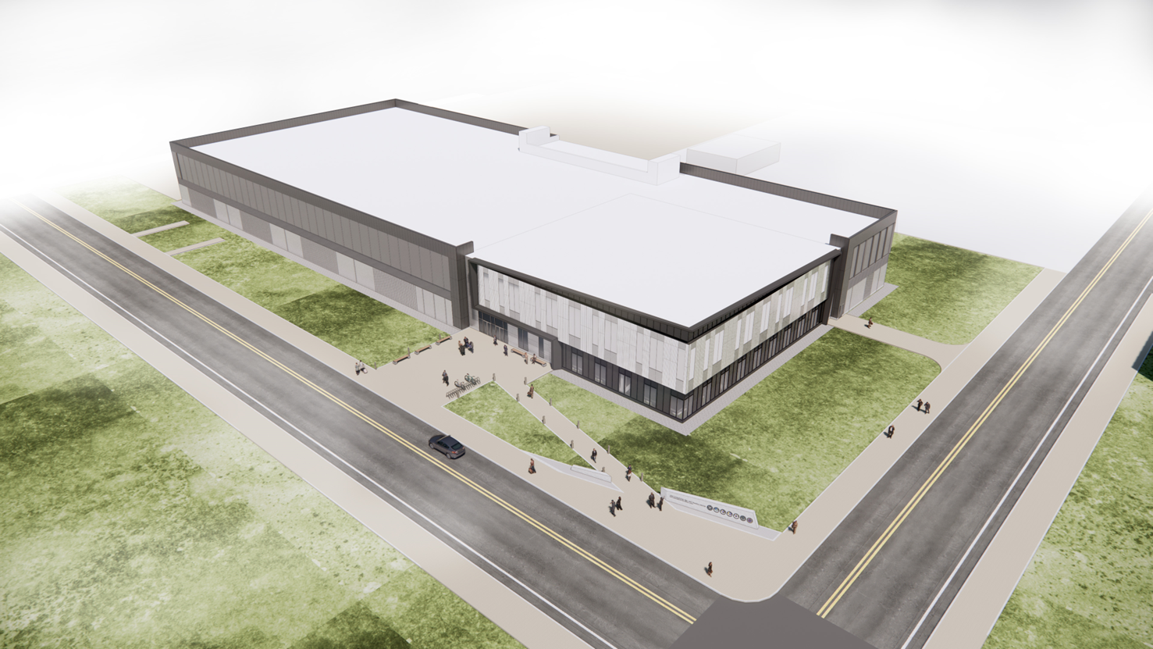
Joint integrated testing & training center (JITTC), Jber, Alaska
Value: $250M - $400M
Target Award: 4QFY25
Type of work: SCIF and security
Major Scope Tasks
Spaces include 118,536 square-feet of Sensitive Compartmented Information Facility (SCIF) spaces.
10 simulator rooms
Briefing rooms
Mission operation centers
A central server room
An auditorium for 200 persons
Administrative space
The JITTC Flight Simulator Training Facility is a 150,852 gross square-foot two-story structure with reinforced concrete foundations, structural steel frame, insulated steel panel and masonry walls, and standing seam metal and membrane roof.

Slide 4
Sustainment, restoration, and modernization FISCAL YEAR 2025-2026
PROJECT / LOCATION | VALUE | EXECUTION STRATEGY | CONTRACT TYPE | SOLICITATION TARGET | AWARD TARGET
Mechanical Electrical Building 2 Chiller Replacement, Fort Greely | $3M-5M | D/B/B, AE | Set Aside | 2QFY25 | 3QFY25
Life Safety Repairs Building 1557, Fort Wainwright | $7M – $10M | D/B, AE | Set Aside | 3QFY25 | 4QFY25
Repair Site Fire Alarm System, Eareckson AS | $15M - $20M | D/B/B, AE | Set Aside | 3QFY25 | 4QFY25
IDT1 Facility UPS System Replacement, Fort Greely | $3-5M | D/B/B, AE | Set Aside | 3QFY25 | 4QFY25
Missile Field 2 Power Redundancy, Fort Greely | $5M-10M | D/B/B, AE | Set Aside | 3QFY25 | 4QFY25
Readiness & Control Building 80 kVA UPS(s) Replacement | $5M-10M | D/B/B, AE | Set Aside | 3QFY25 | 4QFY25
Mechanical Electrical Buildings 2 Rockwell Panel Replacement | $3M-6M | D/B/B, AE | Set Aside | 1QFY26 | 2QFY26
Mechanical Electrical Buildings 3 Rockwell Panel Replacement | $3M-6M | D/B/B, AE | Set Aside | 2QFY26 | 3QFY26
Repair PP Barracks B4062, Fort Wainwright | $20M - $30M | D/B/B, IH | Unrestricted | 2QFY26 | 4QFY26
Notes: D/B/B – Design/Bid/Build; D/B – Design/Build; AE – Architect/Engineer; IH – In House

Slide 5
Civil Works CONSTRUCTION OPPORTUNITIES FISCAL YEAR 2024-2027
PROJECT / LOCATION | VALUE | EXECUTION STRATEGY | CONTRACT TYPE | SOLICITATION TARGET | AWARD TARGET
Nome Port Modifications Phase 1, Nome | $500M - $750M | D/B/B, IH | Unrestricted | 2QFY25 | 4QFY25
St George Navigation Improvements * | $100M - $150M | D/B/B, AE | Constr Not Yet Funded | TBD | TBD
Nome Port Modifications Phase 2, Nome* | $50M - $100M | D/B/B, IH | Unrestricted | 2QFY26 | 3QFY26
Elim Navigation Improvements, Elim* | $70M - $90M | D/B/B, AE | TBD | 3QFY25 | 4QFY25
Lowell Creek – Flood Diversion System, Seward* | $150M - $200M | D/B/B, IH | Unrestricted | 3QFY26 | 4QFY26
Nome Port Modifications Phase 3, Nome* | $100M - $150M | D/B/B, IH | Unrestricted | 4QFY26 | 1QFY27
* Pending Authorization
Notes: D/B/B – Design/Bid/Build; D/B – Design/Build; AE – Architect/Engineer; IH – In House

Slide 6
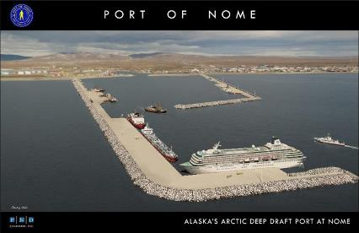
Nome Port Modifications, Nome, Alaska
Three Phase Construction
Phase | Value | Target Award | General Scope
Phase 1* | $500M - $750M | 4QFY25 | West Causeway extension
Phase 2 | $50M - $100M | 2QFY25 | Dredging of basin
Phase 3 | $100M - $150M | 4QFY26 | East Breakwater realignment
The project would construct a new deep-water basin to a depth of -40 feet (ft) mean lower low water (MLLW), deepen the outer basin from -22 ft MLLW to -28 ft MLLW, extends the west causeway by 3,484 ft and constructs 2,000 ft of useable dock moorage area, removal of the existing west breakwater, construction of a 3,900 ft east causeway/breakwater, and construction of 400 ft long docks in the outer basin on the east causeways.
Major Scope Tasks
Construct ~3500 feet of causeway extension with 18 ton well keyed armor
Construct approx. 2000 feet of open cell sheet pile dock face
Dredge basin to -40 ft MLLW
Phase 1 may be done in two contract actions depending on funding

Slide 7
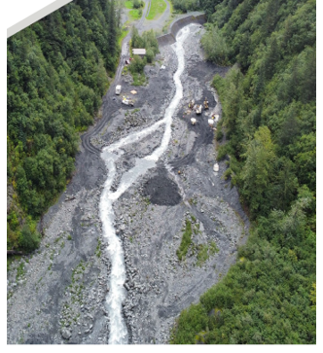
Lowell Creek – Flood Diversion System, Seward
Value: $150M - $200M
Target Award: 4QFY26
Type of work: Diversion structure and tunnel construction
The new flood diversion project would reduce the risk to life safety to the City of Seward posed by flood events from Lowell Creek. The project would construct a new 18-foot diameter tunnel capable of diverting flow of 8,500 cubic feet per second, 150-foot-long tunnel outfall over Lowell Point Road, and refurbishment of the existing tunnel liner.
Major Scope Tasks
Construct concrete lined diversion/inlet channel
Construct concrete bypass diversion structure
Tunnel approximately 2000 linear feet of 18 foot diameter tunnel
Construct outfall flume structure

Slide 8
environmental OPPORTUNITIES FISCAL YEAR 2025
PROGRAM / PROJECT | VALUE | Execution Strategy | CONTRACT TYPES | SOLICITATION TARGET | AWARD TARGET
Formerly Used Defense Sites (FUDS) Program | $5-10M | AE or Env Services | Various | 1Q-3QFY25 | 3QFY25
Army and Air Force Environmental Programs | $10-15M | AE or Env Services | Various | 2Q-3QFY25 | 3Q and 4QFY25
Army and Air Force Compliance/Quality Programs | $10-15M | AE or Env Services | Various | 2Q-3QFY25 | 3Q and 4QFY25
Interagency Environmental Program | $6M | AE or Env Services | Various | 3QFY25 | 4QFY25
Environmental Quality Support Services (Task Orders) | $8-10M | Services | Small Business | 2Q-3QFY25 | 4QFY25
Environmental Remediation Services (MATOC) | $97M | Services | Small Business | 2QFY25 | 4QFY25
Air Force Alaska Fence to Fence Environmental Services (SATOC) | $76M | Services | Small Business | 2QFY25 | 4QFY25
Notes:
FUDS smaller anticipated program. Possibility for additional funding if Fort Glenn removal action is approved. Kodiak Drury Gulch remedial action. Other RI/FS phase projects.
Air Force spill response, Wake Island/Eareckson solid waste disposal, PFAS remedial investigations, remedial action operations/long term management.

Slide 9
UPDATES FROM construction
RMS Replacement – Construction Management Platform (CMP) - Contract to be awarded by end of 1st Quarter FY25 – two years implementation after award.
CQM-Course – Fairbanks (3): 13-14 Nov; 4-5 Mar; 23-24 Apr
Anchorage (4): 17-18 Oct; 20-21 Feb; 20-21 Mar; 8-9 May
Virtual (2): 24-25 Mar; 9-10 Apr
Partnering – Improved communications and issue resolution. Strive for open and honest communications. Engage even if not part of formal contract requirements. Start early and include all levels of the project team.
Issue Resolution – REAs and Claims only get more complicated and less clear with time. Elevate these EARLY which will greatly expedite decisions. Escalation ladders are a best practice.

Slide 10
construction and operations division
Jim Jeffords
Chief, Construction and Operations
Karey Park
Chugach Area Office
Mark Kelliher
Denali Area Office
Geoffrey Ries
Civil Works / EAR
Andrew Posma
Fort Wainwright
Colleen Jordan
JBER
John Dutton
Eielson
Matt Folk
Moose Creek Dam
Brad Bradley
Fort Greely / Clear
Rolf Ness
JBER Runway

Slide 11
FY 24 SAFETY
https://www.usace.army.mil/missions/safety-and-occupational-health/

Slide 12
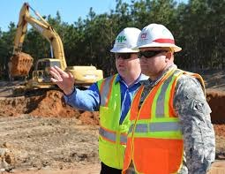
Engineering best practices and AGC – USACE Collaboration Accomplishments
BEST PRACTICES
Construction Quality starts with Design Quality – “Get the Engineering Right’
Utilize and implement Design Quality Control Plan (DQCP)
Empower the Design Quality Control Manager (DQCM) to uphold quality standards throughout contract
Maintain healthy and effective partnership through communication, collaboration, and commitment.
AGC - USACE COLLABORATION ACCOMPLISHMENTS
Integrating Milestone Outlines Design Build (DB) and Design-Bid-Build (DBB) Requests for Proposal (RFPs) – Improves clarity, reduces submittal rejections, and enhances delivery.
Including Construction Phase Services Task Orders on DBB projects – Ensures prompt Request for Information (RFI) resolution preventing schedule and cost overruns during construction.
Revised drawing specifications stating the graphic standards for drawings in the RFP will be maintained post award using the same standards. Puts the onus on the USG to assure to current AEC graphic standards are provide in the RFP.
Provided Cyber Security Guidance for Digital/Analog Systems in the areas of UFC compliance, personnel training requirements and FAR compliance prohibitions for brand specific products.

Slide 13
Best practices contracting
Participate in Market Research
Track SAM.gov (https://sam.gov/) and respond to sources sought notices – for AK District USACE announcements use keyword “W911KB”
If you’ve never worked with the Alaska District before, consider –
Subcontracting OR Partnership (JV, Mentor Protégé)
Know the solicitation, Ask questions during solicitation process, Attend site visits
Submit everything that is asked for in solicitation,
Make it as simple for the Government to evaluate your proposal as you can
FY24 Lessons Learned
PLAs adding about 30 days to solicitation time (Enterprise Wide)
8a sole source are still important tool for meeting short suspense EOY requirements
FY25 Looking forward
USACE will deploy a new Army Contract Writing System – Alaska District, Mid to Late February 2025
Stipends on Design Build Projects
Communicate freely to resolve issues at the lowest level at the time of their occurrence

Slide 14
Project labor agreements (PLA’s)
Executive Order 14063 implementing the new PLA rule is effective for new solicitations entered into on or after 22 January 2024.
Required for large-scale construction projects, with performance in the United States and an anticipated total estimated construction contract value of $35 million or greater. Does not apply to dredging.
Since USACE is not an employer engaged primarily in the building and construction industry, USACE will neither negotiate nor become signatory to a PLA.
Alaska District is using the basic version of FAR Clause 52.222-33, Notice of Requirement for Project Labor Agreement, (all offerors required to submit a PLA with their offer); the PLA will be evaluated during the source selection process on an Acceptable/Unacceptable basis.

Slide 15
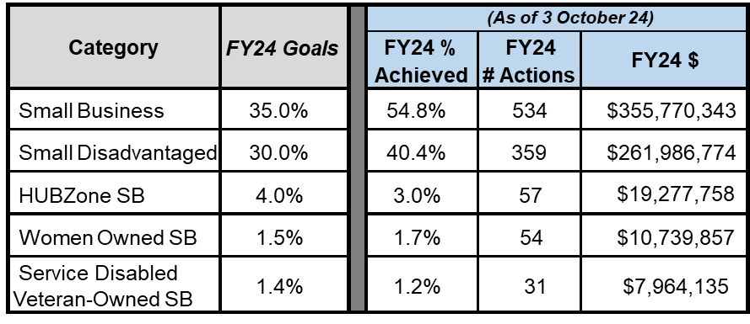
Best practices Small Business Execution
Communicate & Stay up to Date
Participate in Market Research
Keep capabilities statements updated
Long-term Contract Opportunities
(POA SB site below)
USACE Enterprise-wide Upcoming Opportunities:
Procurement Forecast, Calendar,
Resources and more at the Alaska District OSBP site:
https://www.usace.army.mil/Business-With-Us/Small-Business/Upcoming-Contract-Opportunities/
Total SB $ in FY24: $355.8M
60% of actions to SB in FY24
https://www.poa.usace.army.mil/Business-With-Us/Office-of-Small-Business-Programs/

Slide 16
USACE POA Small Business WEBSITE

Slide 17
CONTACTS U.S. Army Corps of Engineers – Alaska District
Contracting Division
Deputy, Contracting Division – Michelle Mandel
Phone: 907-753-2502 / Email: Michelle.R.Mandel@usace.army.mil
Civil Works Program
Cooperative Agreements
Chief, Military Branch – Theresa Afrank
Phone: 907-753-2739 / Email: Theresa.M.Afrank@usace.army.mil
Military Construction Program
Missile Defense Program
Chief, Special Projects Branch – George Nasif
Phone: 907-753-2838 / Email: George.G.Nasif@usace.army.mil
Environmental Program
Interagency Program
International Program
Small Business Office
Small Business Professional – Ryan Zachry
Phone: 907-753-5557 / Email: ryan.b.zachry@usace.army.mil

